Slide 1

Department of Computer Engineering
Quine- Mcclunsky minimization technique
1

Slide 2
Points covered
Department of Computer Engineering
Quine- Mcclunsky minimization technique

Slide 3
Department Vision & Mission
Department of Computer Engineering
Vision
Achieve academic excellence through education in computing, to create intellectual manpower to explore professional, higher educational and social opportunities.
Mission
To impart learning by educating students with conceptual knowledge and hands on practices using modern tools, FOSS technologies and competency skills there by igniting the young minds for innovative thinking, professional expertise and research.
3

Slide 4
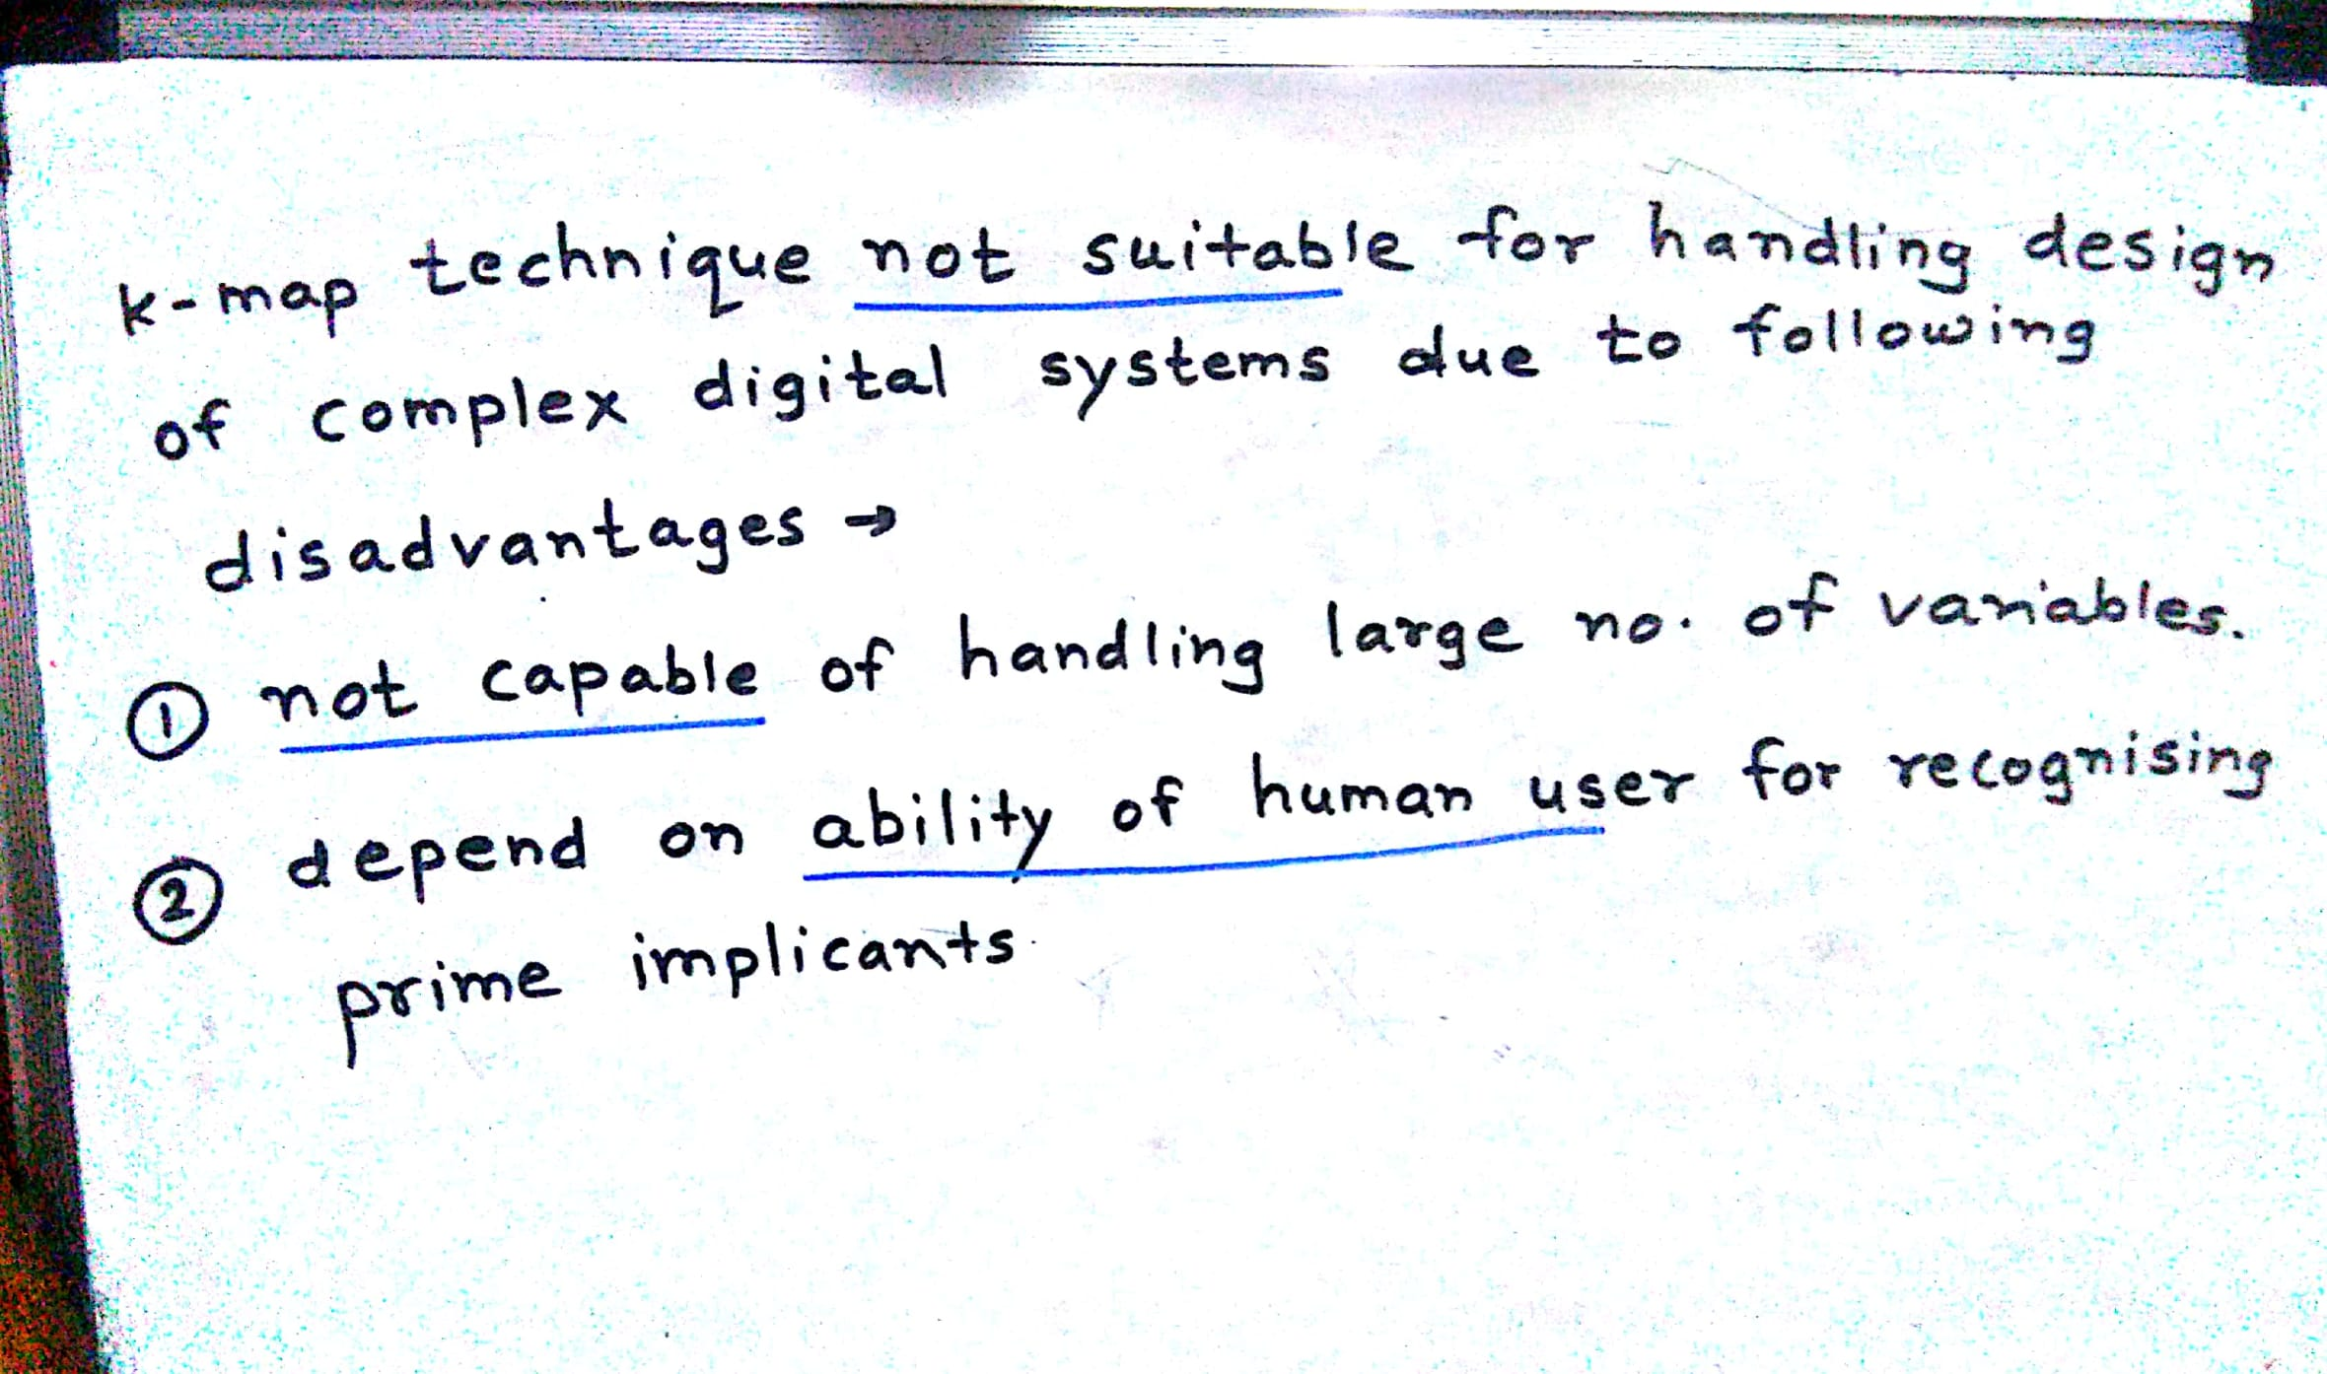
Department of Computer Engineering
Quine- Mcclunsky minimization technique

Slide 5
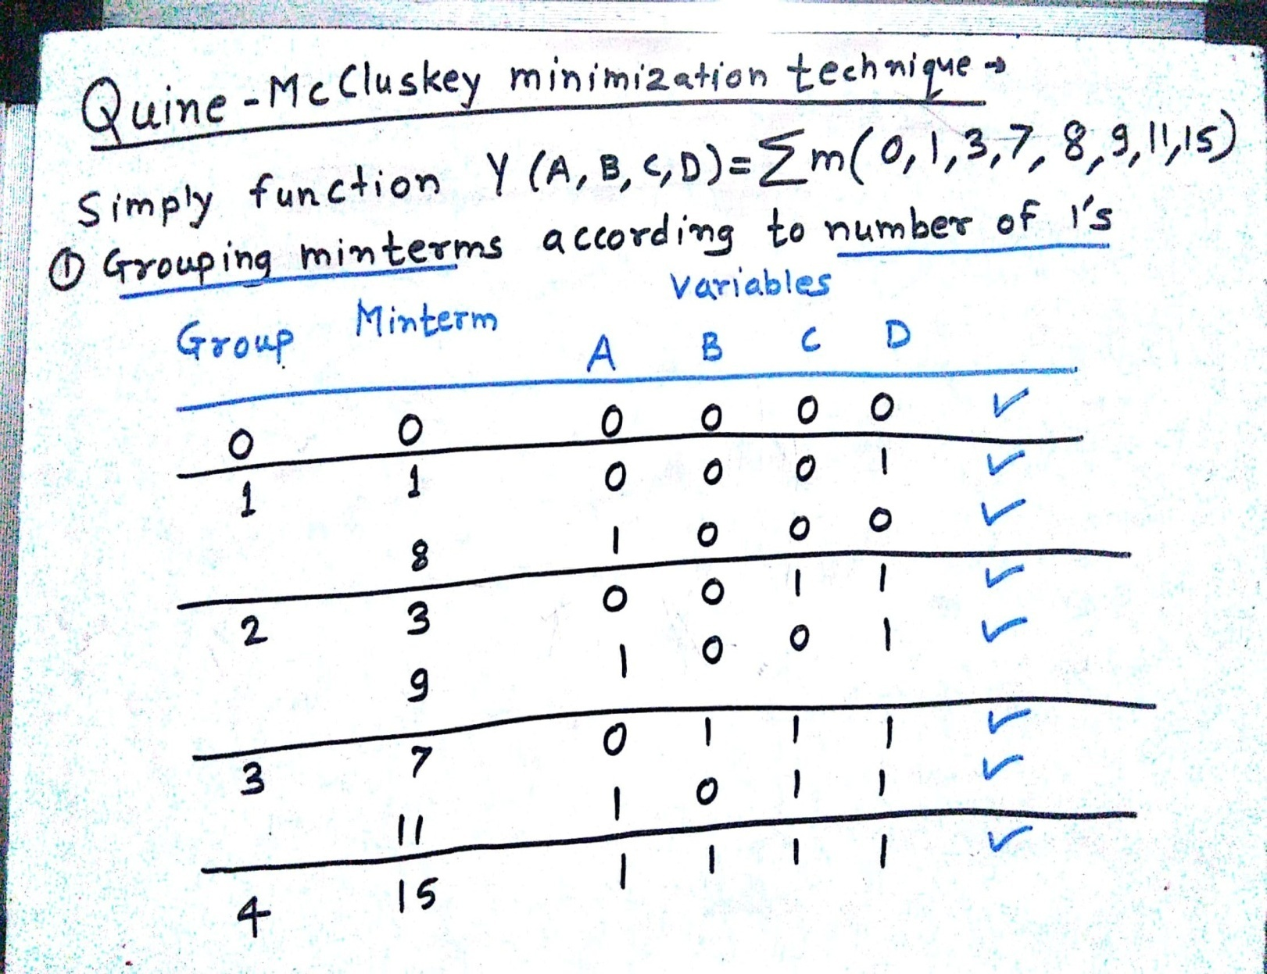
Step 1: Group based on no. of one’s
Dec | A | B | C | D
0 | 0 | 0 | 0 | 0
1 | 0 | 0 | 0 | 1
3 | 0 | 0 | 1 | 1
7 | 0 | 1 | 1 | 1
8 | 1 | 0 | 0 | 0
9 | 1 | 0 | 0 | 1
11 | 1 | 0 | 1 | 1
15 | 1 | 1 | 1 | 1

Slide 6
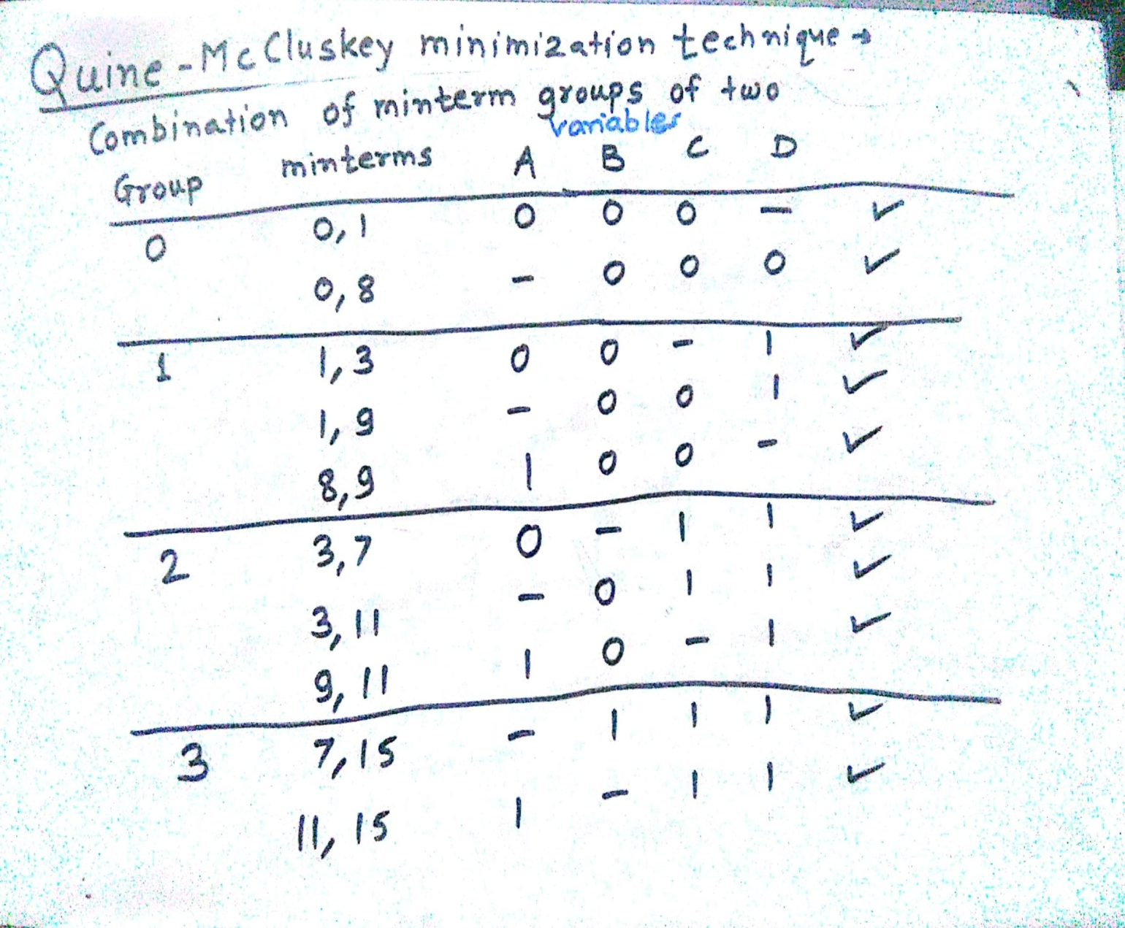
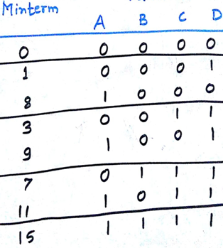
Steps: Find pair of minterms in which only one variable is minterm such that A+A’ =1
Department of Computer Engineering

Slide 7
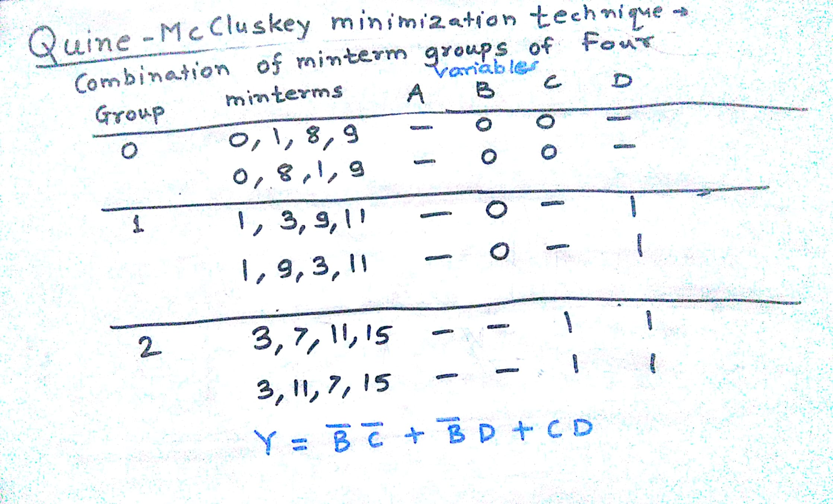
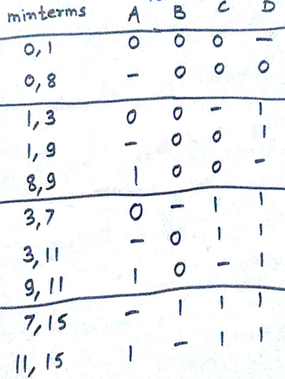
Steps: Find pair of minterms in which only one variable is minterm such that A+A’ =1

Slide 8
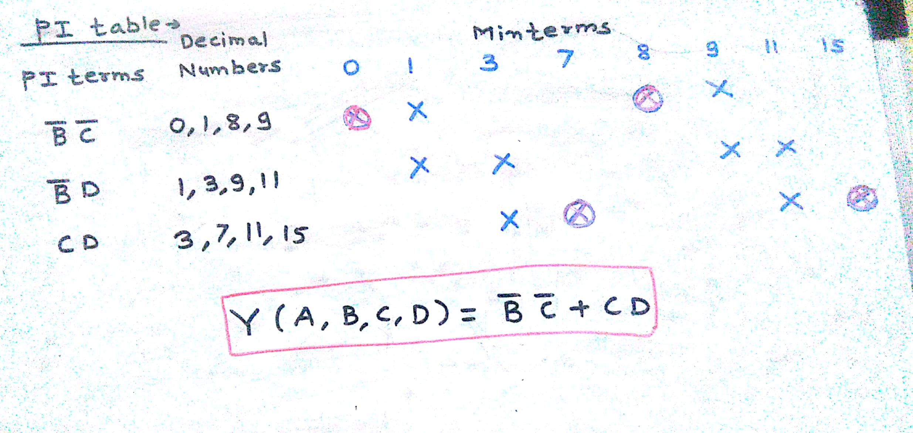
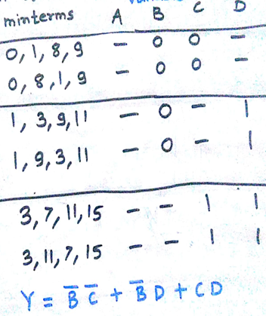
Prime Implicant Table
The minterms 0 and 8 are contained in only one PI B’C’
The minterms 3 and 7 are contained in only one PI CD
Therefore prime implicants B’C’ and CD are essential PI
The minterms 1, 9 of B’D’ contained in B’C’
The minterms 3,11 of B’D’ contained in CD
The minimized expression is coming as above

Slide 9
Department of Computer Engineering
Homework
F (A,B,C,D) = Σm(0,1,2,3,5,7,8,9,11,14)

Slide 10
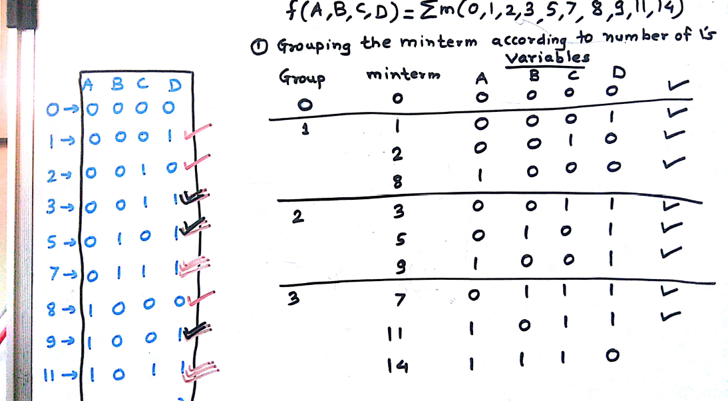

Slide 11
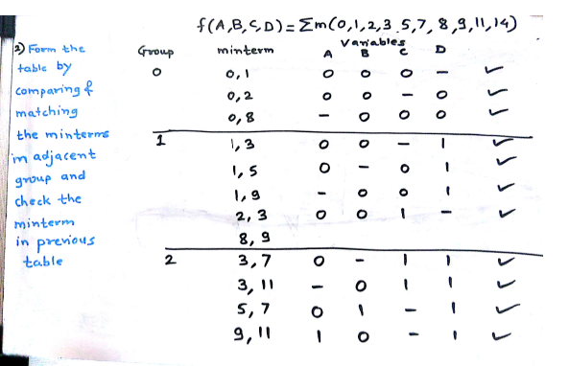
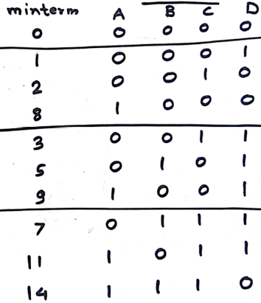

Slide 12
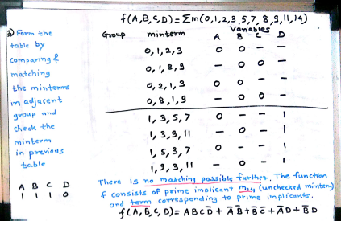
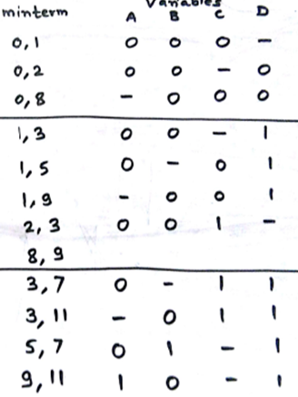

Slide 13
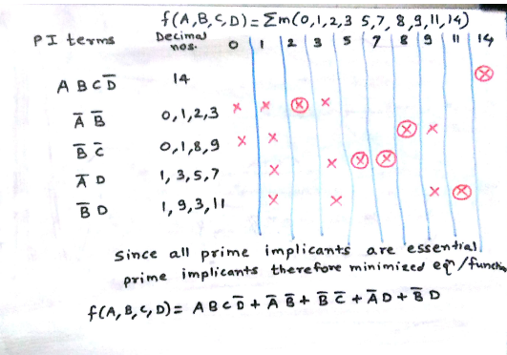

Slide 14
Department of Computer Engineering
Homework
F (A,B,C,D) = Σm(0,1,2,3,5,7,9)

Slide 15
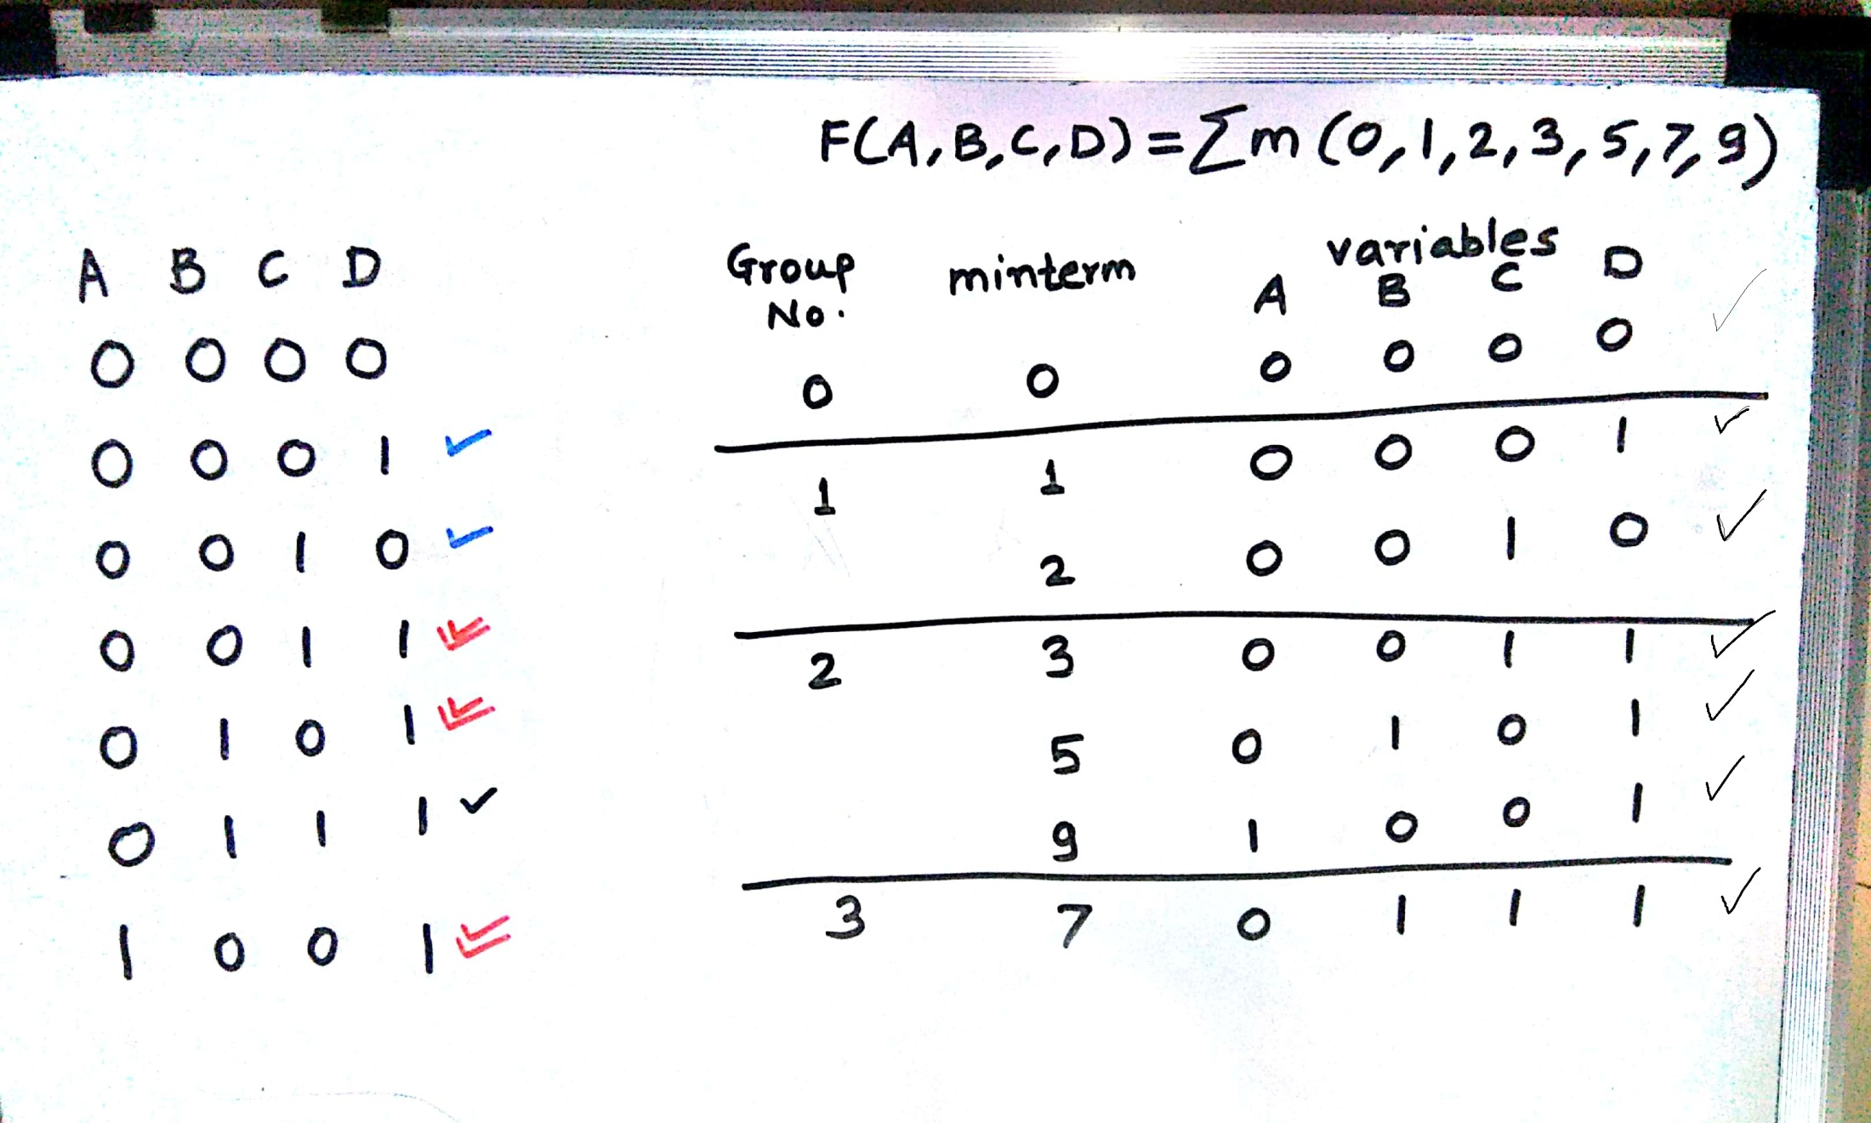
Department of Computer Engineering

Slide 16
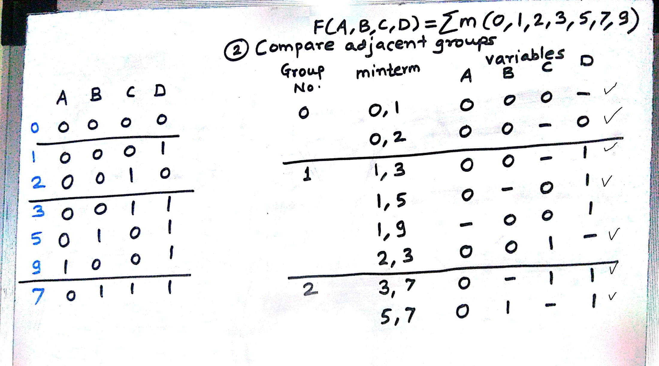
Department of Computer Engineering

Slide 17
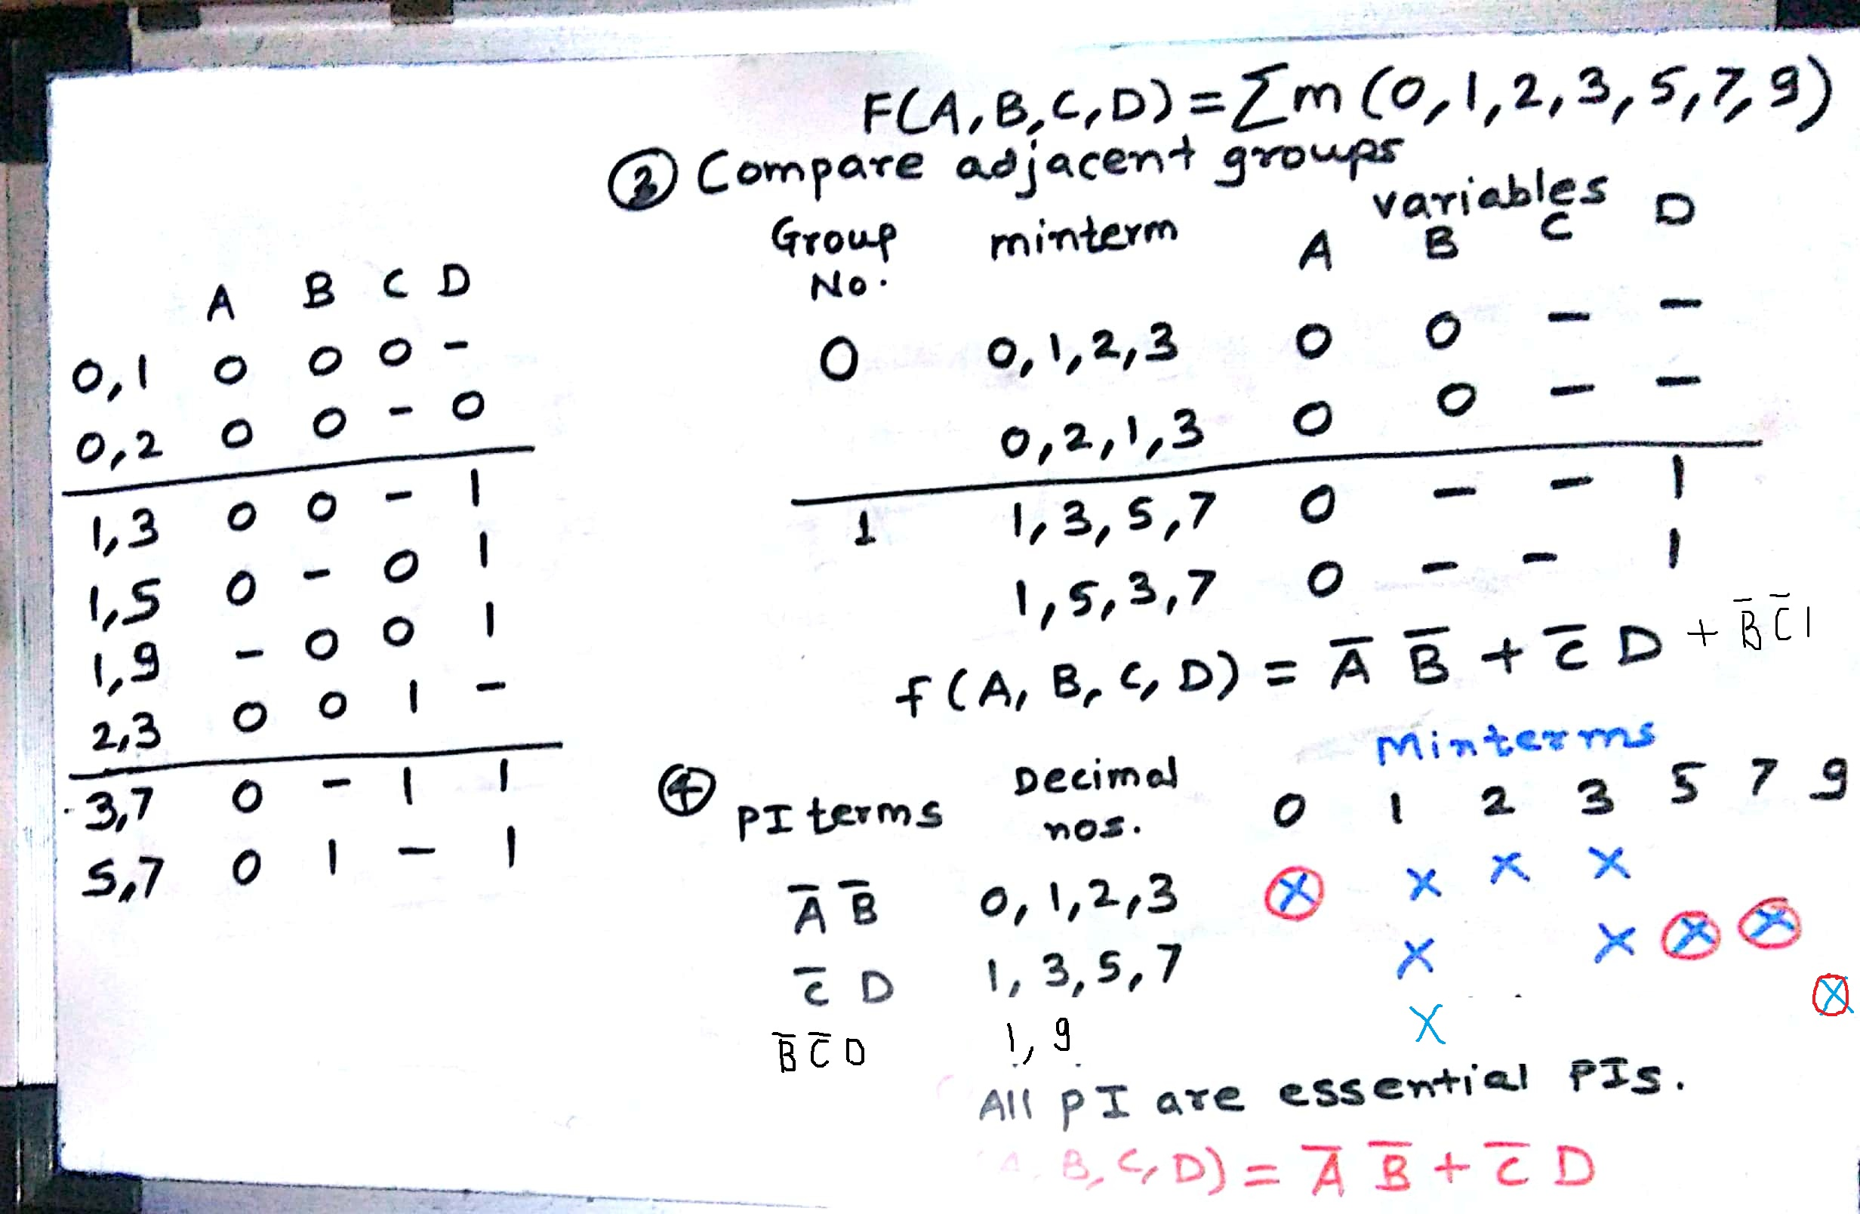
Department of Computer Engineering

Slide 18
Department of Computer Engineering
F (A,B,C,D) = Σm(1,3,7,11,15) + d(0,2,5)

Slide 19
Summary
Department of Computer Engineering
Quine- Mcclunsky minimization technique

Slide 20
Department of Computer Engineering
Thank you

